Slide 1

Web scraping to gain company insights

Slide 2
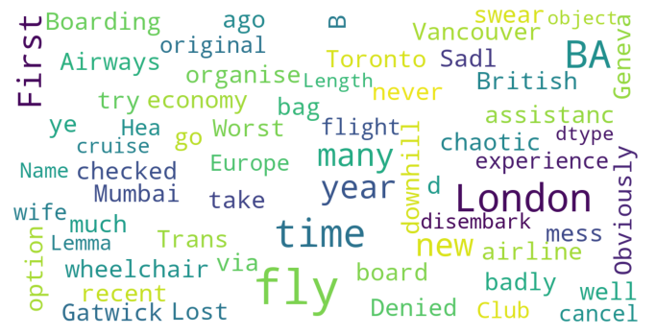
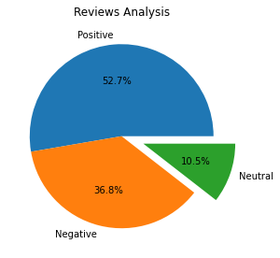
Insights
From 1000 reviews we obtained :
527 Positive Reviews
368 Negative Reviews
105 Neutral Reviews
Word cloud of keywords in reviews

